Slide 1
Machine learning
Introduction to Machine Learning
Vincent Vankrunkelsven

Slide 2
Content
What is Machine Learning?
Performance Measures
Classification
Regression
Clustering

Slide 3
What is Machine Learning?
Machine Learning (ML) problems involve information with three characteristics:
Observations rows in a dataframe
Features input columns in a dataframe
Labels output column in a dataframe
ML applies various algorithms to information to derive an estimated function. This estimated function’s parameters are tuned based on how the information’s feature values map to label values across a subset of observations within the information set.
Applied R (Studying Information)
dim(df) ⬅ vector with the number of rows and columns in the dataframe (df)
str(df) ⬅ detailed information about the structure of df
head(df) / tail(df) ⬅ first / last six rows of df
summary(df) ⬅ statistical information for each column in df
One of the key goals of ML is making predictions about new observations based on previous information.
ML does not involve basic data manipulation and/or calculating statistics,
Applied R (Linear Regression Example)
Wage ⬅ Use tools from Applied R (Studying Information) to study the Wage dataset
lm_wage <- lm(wage ~ age, data = Wage) ⬅ linear regression model on Wage that models wage as a function of age
unseen <- data.frame(age = 60) ⬅ unseen is a dataframe consisting of a new observation
predict(lm_wage, unseen) ⬅ makes a prediction of wage based on age for the unseen observation
estimated function
prediction
new obsevation
information set
ingredients of a classical ML problem

Slide 4
Assessing Performance
Accuracy
Computation time
Interpretability
Accuracy and Error are basic performance measures for Classification MLP

Slide 5
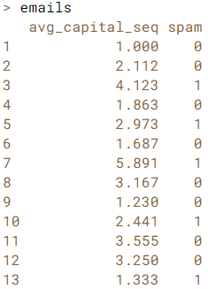
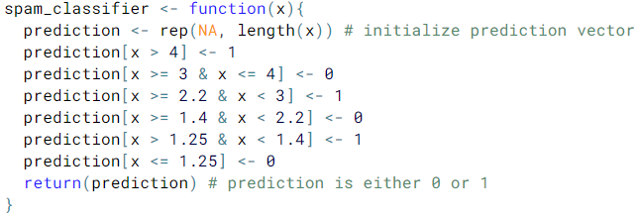

Classification
Classification MLP attempt to predict the category of a new observation.
Earlier Observations are used to estimate a Classifier
The classifier is then used to label a new observation with a Class
Classes are qualitative and predefined
Applied R (Classification: Filter Spam)
In this example the training data (emails) is used to develop the Classifier. However this is not a valid approach in an actual classification MLP.
Classifier
feature vector
label on observed data
Class predictions from our Classifier

Slide 6
Regression
Regression MLP attempt to estimate a Response value after a set of Predictors are pushed through a Regression Function.
In linear regression, the regression function is estimated by two paramaters β₀ and β₁
Applied R (Studying Information)

Slide 7
Clustering
Clustering MLP attempt to group similar objects in clusters while ensuring that each cluster is dissimilar from every other cluster.
Clustering is similar to classification MLP however the important distinction is that in clustering, the classes, or clusters, are not predefined.
Applied R (Studying Information)

